Slide 1

QuizGuard Using API
Group members with Student Id
Soham Jathar-23106084
Prathamesh Kolhe-23106132
Bhavika Kadam-23106079
Onkar Deshmukh-23106006
Project Guide
Prof. Snehal Kangane

Slide 2
Introduction : Quiz Guard Powered by API
A secure online quiz-taking app is a platform that allows users to take quizzes or exams remotely while ensuring the integrity and privacy of the process. It typically includes features such as user authentication, real-time monitoring, anti-cheating mechanisms, time limits, and data encryption to protect both participants and quiz content. These apps provide a seamless and secure experience for learners, educators, and organizations alike, making it easier to assess knowledge and skills in a controlled, trustworthy environment.

Slide 3
Literature survey
Publication Name | Year | Author(s) | Drawbacks Highlighted
"Innovations in Proctoring Systems" | 2023 | Robert White, Emily Black | "While AI-based proctoring solutions are emerging, they often struggle with false positives, flagging innocent actions as suspicious."
"Fairness in Online Exam Environments" | 2022 | Anna Clarke, David Young | "The fairness of online exams is compromised due to unequal access to technology among students, exacerbating disparities."
"The Reliability of Remote Testing" | 2021 | Sarah Lee, Tom Harris | "Remote exams often face connectivity issues, leading to interruptions, and the absence of physical supervision increases the likelihood of cheating."

Slide 4
Publication Name | Year | Author(s) | Drawbacks Highlighted
"Challenges of Online Exam Proctoring" | 2020 | John Doe, Jane Smith | "Online exam proctoring faces issues with authentication, resulting in identity fraud, and lacks effective monitoring tools for detecting cheating."
"A Survey of Digital Exam Systems" | 2019 | Michael Brown, Lisa Ray | "Current digital exam systems lack the robustness to handle large-scale exams, resulting in system failures during peak load."

Slide 5
Limitations of Existing Systems
Lack of Security
Poor User Experience
Limited Functionality
Existing systems often lack robust security measures, leading to cheating.
Unintuitive interfaces and limited functionalities hinder user experience.
Many platforms lack essential features like time limits and anti-cheating mechanisms.

Slide 6
Problem Statement
The traditional methods of conducting quiz exams in educational settings often face challenges related to efficiency, personalization, and real-time assessment, which can limit their effectiveness in fostering student learning. These conventional systems are typically static, offering the same set of questions for every student, regardless of their individual learning needs or abilities. This one-size-fits-all approach can result in either overly easy or excessively difficult exams, leading to disengagement or frustration among students. Additionally, the time-consuming process of grading and providing individualized feedback further burdens educators, preventing them from focusing on more meaningful, personalized instruction. Furthermore, traditional quizzes may not accurately reflect a student's true understanding, as they fail to adapt to various learning styles and cognitive abilities.

Slide 7



Problem Statement
Challenge
1
Maintaining exam integrity and ensuring a fair assessment for students.
Goal
2
Develop a secure, user-friendly platform for online quizzes.
Solution
3
Secure Online Quiz Guard, a platform designed for secure and efficient online assessments.

Slide 8
System Design
User Interface (UI)
Database
An intuitive and user-friendly interface for creating and taking quizzes.
Stores quiz data, user information, and performance metrics.
1
2
3
4
Backend Server
Security Module
Handles quiz creation, storage, delivery, and scoring logic.
Implements anti-cheating measures like time limits and tab monitoring, camera and noise detection

Slide 9
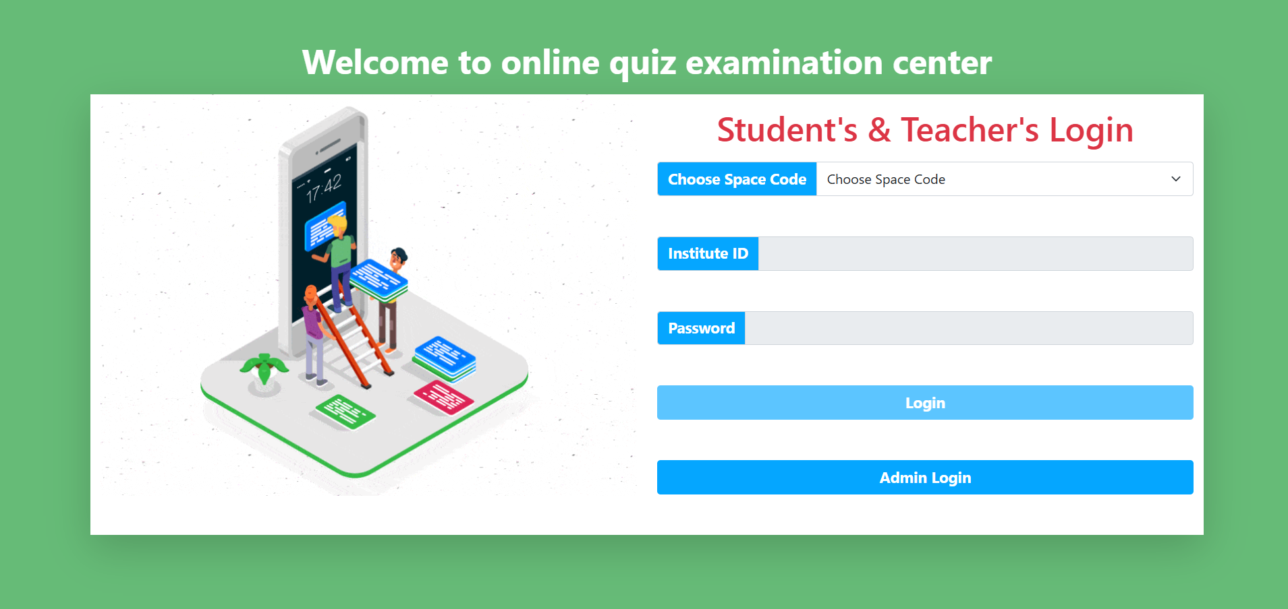
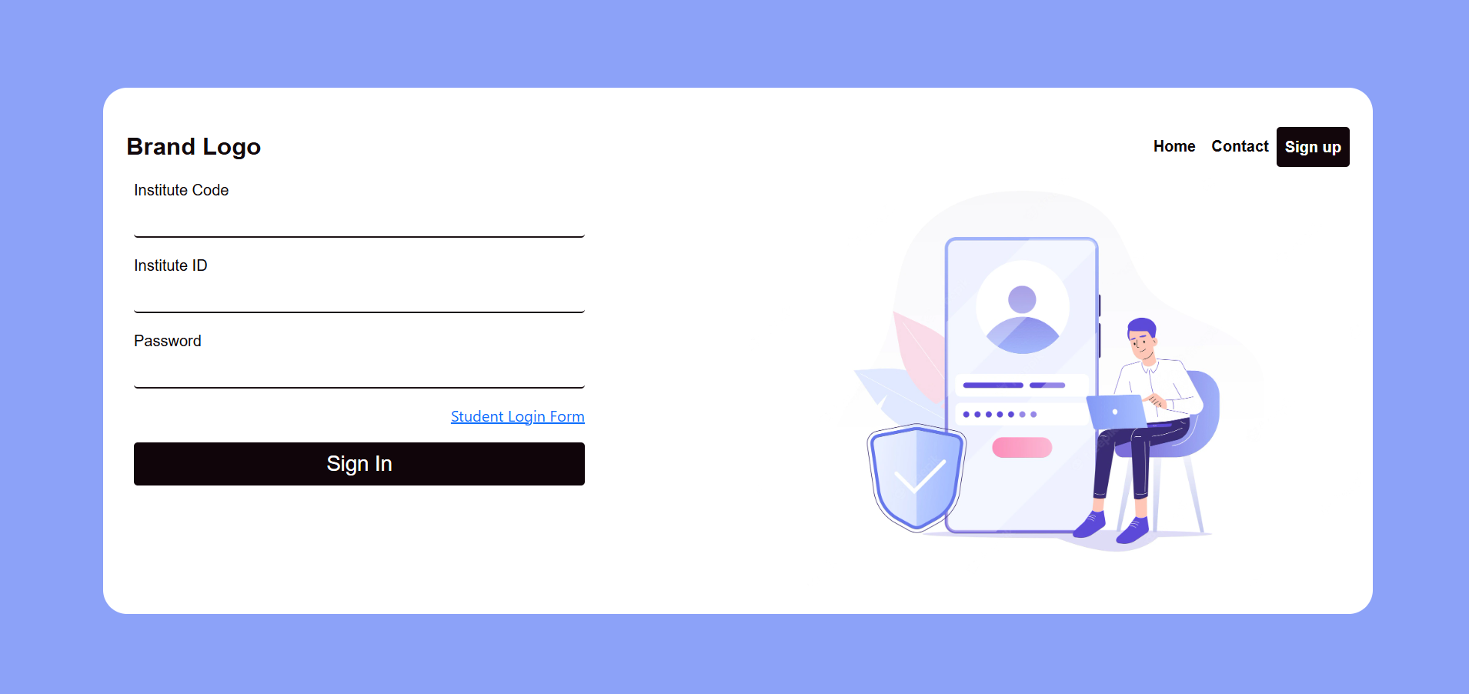
Implementation : Screenshots of user-interface
Student Login Page
Admin Login Page

Slide 10
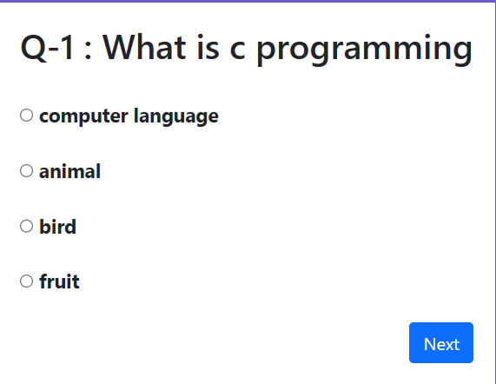
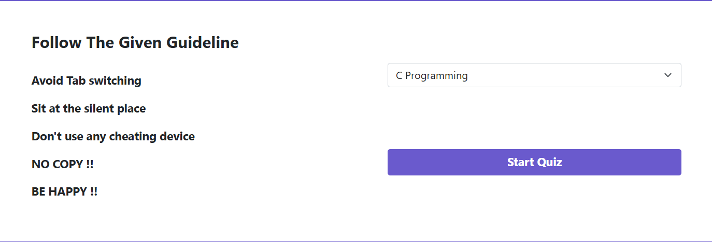
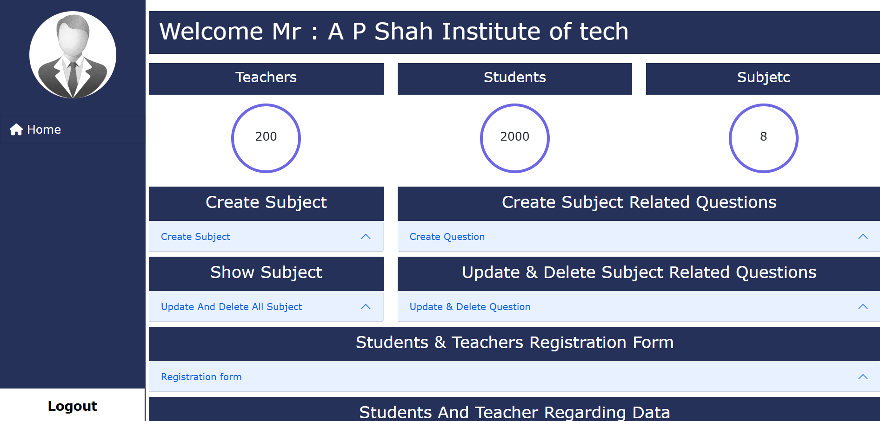
Student dashboard
Admin Dashboard

Slide 11

Technologies and Methodologies
HTML5 : Structure of the web pages
CSS3 (Bootstrap, Custom CSS) : Styling and responsive design
JavaScript (Vanilla JS, jQuery) : Client-side scripting
Web Audio API : Processed the audio to analyze frequency and volume levels.
Database : Browser Local Database

Slide 12
Conclusion
Secure
1
Secure Online Quiz Guard guarantees exam integrity with time limits and anti-cheating features.
User-Friendly
2
The platform provides a seamless and enjoyable experience for both instructors and students.
Efficient
3
The platform simplifies quiz management, allowing instructors to focus on teaching.

Slide 13
Reference :
"Challenges of Online Exam Proctoring" – 2020 – John Doe, Jane Smith
"A Survey of Digital Exam Systems" – 2019 – Michael Brown, Lisa Ray
"The Reliability of Remote Testing" – 2021 – Sarah Lee, Tom Harris
"Fairness in Online Exam Environments" – 2022 – Anna Clarke, David Young
"Innovations in Proctoring Systems" – 2023 – Robert White, Emily Black
"Improving the Integrity of Online Exams" – 2020 – William Green, Olivia Hill

